Slide 1
The history of groups
Notes:
Here are suggested teacher notes for delivering the content on this slide: Notes: - The earliest philosophers were known as "sages" who questioned traditions and applied reason to understand the world - Ask students if they can think of any ancient traditions or beliefs that philosophers may have questioned (e.g. flat earth, earth as center of universe, mystical explanations of natural phenomena) - Explain that sages were curious about the natural world, human nature and society - Give examples of what early philosophers explored related to nature (e.g. Thales theorizing that water was the first/fundamental element) - Ask students to discuss in pairs: Why do you think early philosophers focused so much on understanding nature, human nature and society? After a few minutes, have some students share out. - As an exercise, have students research an early philosopher/sage and prepare a short summary on what topics/questions they explored and what conclusions they came to. Ask volunteers to share out a few examples. - Extension exercise: Ask students to write a short imaginary dialogue between two early philosophers debating different theories about the natural world or human nature. Let me know if you need any clarification or have additional suggestions for communicating this content!

Slide 2
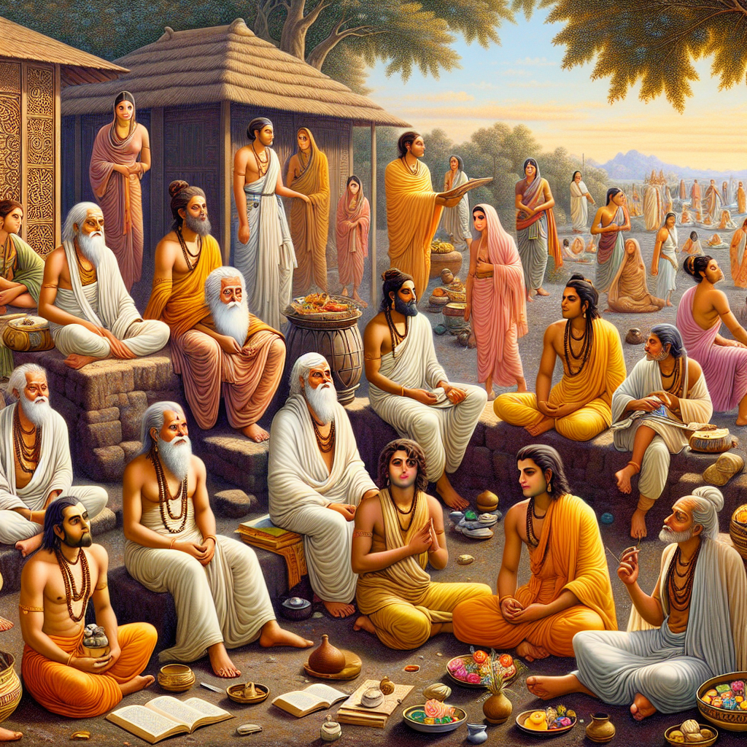
Title: Sages in India In India, the "Seven Sages" or Saptarishi played a key role in Hinduism. They were considered wise and authored ancient Indian texts. They lived monastic lives and gained wisdom through spiritual practices and meditation. Some women like Ghosha, Maitreyi, and Gargi also contributed as sages. They attained enlightenment similar to men. However, over time Indian culture became more patriarchal and limited women's roles.
Notes:
Here are some suggested notes to help a teacher effectively communicate the content in this slide to a class of high ability 12-year-olds: Notes: - Explain the "Seven Sages" or Saptarishi were revered in Hinduism for their wisdom. Discuss some of their key teachings that have endured. - Have students research one of the Sages and share a interesting fact they learned. - Explain that some women also gained recognition as sages equally to men in ancient India. Provide Ghosha, Maitreyi and Gargi as examples. - Contrast the equal status of female sages in the past to the more patriarchal limits on women's roles in later Indian history. - Discussion topic: Should we view historical gender roles in terms of the standards of their time or our modern perspectives? What are the merits of each view? - Essay topic: Pick one female sage and explain her key philosophical ideas and how she attained her respected status.

Slide 3
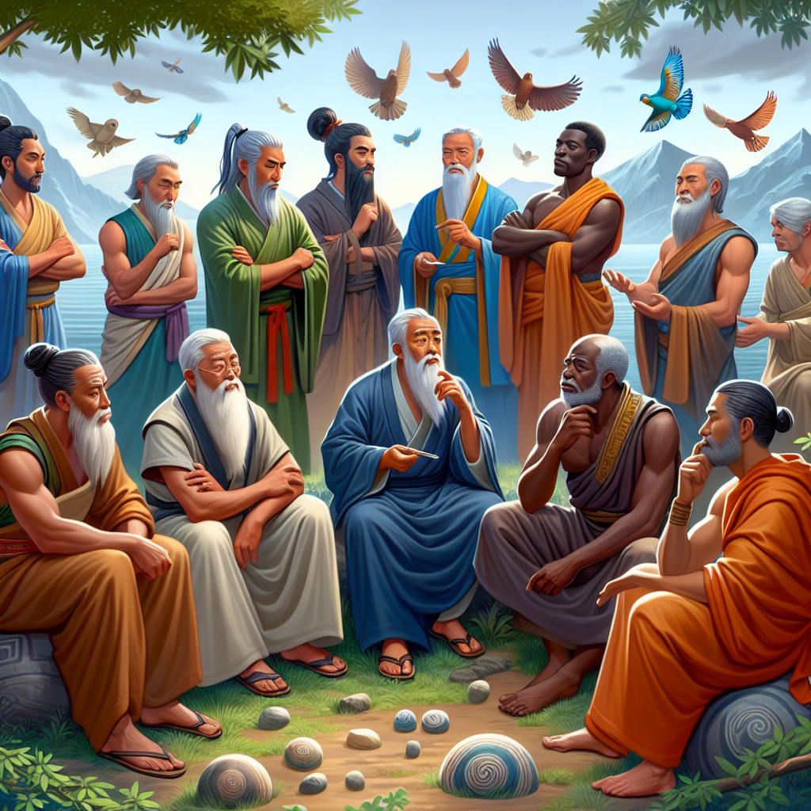
Title: Sages in Other Cultures Sages existed in China, Africa, and Greece as well. Like in India, they were curious about nature and human life. They questioned traditions and tried to understand the world better through reason.
Notes:
Here are suggested teacher notes for delivering the content on the slide titled "Sages in Other Cultures": Notes: - Sages, like philosophers, existed all over the ancient world, not just in India. Point out some famous examples from China (Confucius), Africa, and Greece (Socrates, Plato, Aristotle). - These thinkers were very curious and asked deep questions about the meaning of life, ethics, government, and more. Have students brainstorm what kind of questions they think the sages asked. - They challenged assumptions and traditional beliefs by using reason and logic. Give examples of traditions or beliefs that students think should be questioned or challenged today. - Their goal was to better understand the world and human nature. Ask students why they think understanding the world better is an important goal for thinkers/philosophers. Relevant exercises: - Small group discussion: Each group discusses one ancient sage's ideas and why they were important for their time. - Journal prompt: What is one tradition or assumption that you think should be questioned or challenged today? Explain. - Create a list of questions you think an ancient sage might have asked about human society. Share with a partner. Let me know if you need any clarification or have additional suggestions for delivering this content!

Slide 4

Title: Defining Philosophy Philosophy aims to gain the broadest and deepest understanding of the world. It considers nature, consciousness, morality, beauty and more. Philosophers question assumptions and are open-minded. This makes philosophy complex but also flexible. There are no easy answers in philosophy!
Notes:
Here are some suggested teacher notes for delivering the content on this slide: Notes: - Define philosophy as the pursuit of understanding fundamental truths about concepts like existence, knowledge, values, reason, mind, and language. Emphasize that philosophy tries to gain a comprehensive, deep understanding of the world. - Explain that philosophy considers broad, abstract questions about nature, consciousness, ethics, aesthetics, and more in order to better understand reality and the human experience. - Discuss how philosophers question assumptions and remain open-minded. This makes philosophy complex, as there are no easy or absolute answers. But it also makes philosophy flexible - philosophical ideas evolve over time as new perspectives emerge. Student Exercises: - Have students brainstorm a list of "wonder questions" they think about, like "Where did we come from?" or "What happens after we die?" Use this to explain how philosophy tackles big questions. - Ask students to imagine alien visitors new to Earth. Have half the class ask questions they would pose to the aliens, while the other half of students pretend to be the aliens answering from their unique perspective. This helps stress how questioning assumptions and considering different viewpoints is key to philosophical thinking.

Slide 5

Title: How Philosophers Practice Modern academic philosophers focus on complex relations between different areas of knowledge. For example, understanding connections between: - Human nature and morality - Nature and human society - Scientific discoveries and human consciousness This requires being open-minded, reasonable, and curious - like the ancient sages!
Notes:
Here are some suggested notes to help a teacher effectively communicate the content in this slide to a class of high ability 12-year-old students: Notes: - Modern philosophers make connections between different areas to understand the bigger picture. For example, they may explore: - The link between human nature and morality - what it means to be good - How nature and human society impact each other - How scientific discoveries relate to human consciousness and identity - To do philosophy well requires: - An open and curious mind - Reasonable thinking - Patience in questioning and understanding - Activity ideas: - Ask students to find examples of philosophical questions from movies or books - Have a debate about a philosophical question like "Can robots be conscious?" - Break students into groups to create mind maps showing connections between topics we've discussed

